Slide 1


Customer Behavior Analysis Report
Insights &Strategic Recommendations
Prepared by: sMAYANK P.SAVANI December 8,2025

Slide 2

Project Overview &Objectives
Project Scope
Analysis of 3,900 customer transactions with 18 distinct attributes,generating approximately
$233,081 USD in total revenue.
Customer
Segmentation
Key Business Questions
· How do customer segments differ in spending patterns?
· What factors drive customer loyalty and retention?
· Which products show high discount dependency?
· What behavioral indicators signal churn risk?
Core
Objectives
Loyalty
Dynamics
Behavioral Patterns
Revenue
Distribution
Revenue Analysis:$233,081
Customer Behavior Analysis Report |2025

Slide 3




Methodology &Data Pipeline
Data Preparation | Data Storage &Querying |  | Visualization &Reporting
·Standardized column names to snake_case ·Imputed missing review_rating values ·Created derived features (age_group,loyalty_segment) | ·Exported cleaned dataset to PostgreSQL ·Executed business logic queries in SQL ·Validated outputs for consistency | ·Built interactive dashboards in Power Bl ·Utilized DAX for advanced calculations ·Enabled dynamic data slicing
Data Overview ·Dataset:3,900 transaction records ·Attributes:18 distinct variables | ·Minimal missing values(primarily in review_rating) ·Cross-sectional data without timestamps Customer Behavior Analysis Report |2025

Slide 4

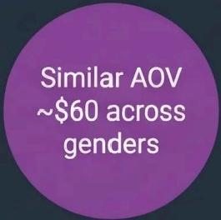
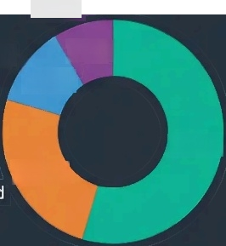
Revenue Distribution Analysis
Revenue by Gender
Male:67.7%($157,890 from 2,652 transactions)
Female:32.3%(S75,191 from 1,248 transactions)
Key Insights
·Male customers generate 67.7%of total revenue despite similar AOV to female customers
·Adults(30-44)and Middle-Aged(45-59)are strongest revenue contributors
·Revenue disparities driven by transaction volume,not spending power
·Opportunity:Increase female customer acquisition for revenue growth
Revenue by Age Group
Senior
Young Adult 9.7%
11.3%
67.7%
Middle-Aged ^{25.5%}
(45-59)
Adults
(30-44)
Customer Behavior Analysis Report|2025

Slide 5
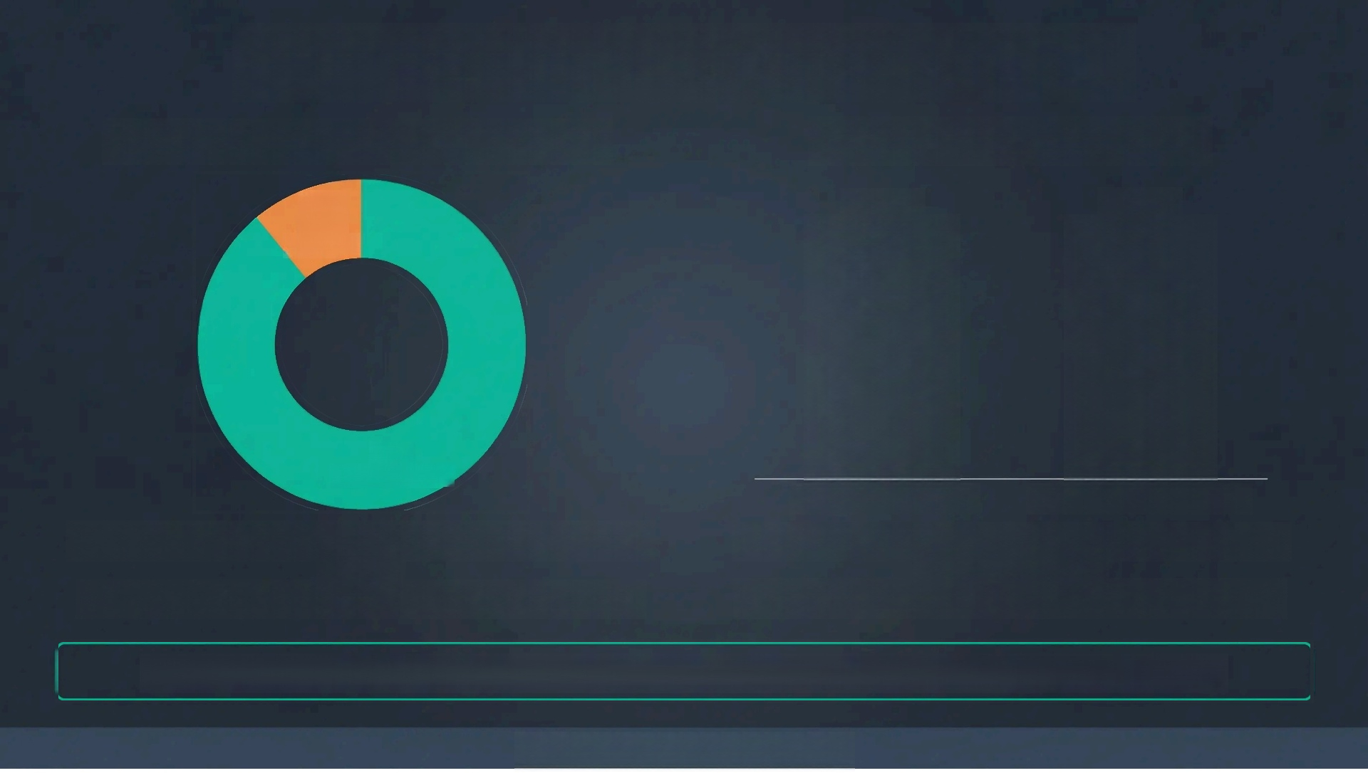

Customer Loyalty &Subscription Insights
Revenue Contribution by Customer Loyalty Subscription Impact on Spending
11% New & | $60 AOV | $60 AOV
Returning 89% Loyal Customers
Subscribed Customers Non-Subscribed Customers
Loyal customers(>5 previous purchases)contribute 89%of total revenue
New and returning customers account for only 11%of revenue
Current subscription program shows no significant impact on Average Order Value
Subscribed customers do not exhibit higher spending habits
Strategic opportunity:Redesign subscription value proposition to drive higher customer spending
Customer Behavior Analysis Report |2025

Slide 6
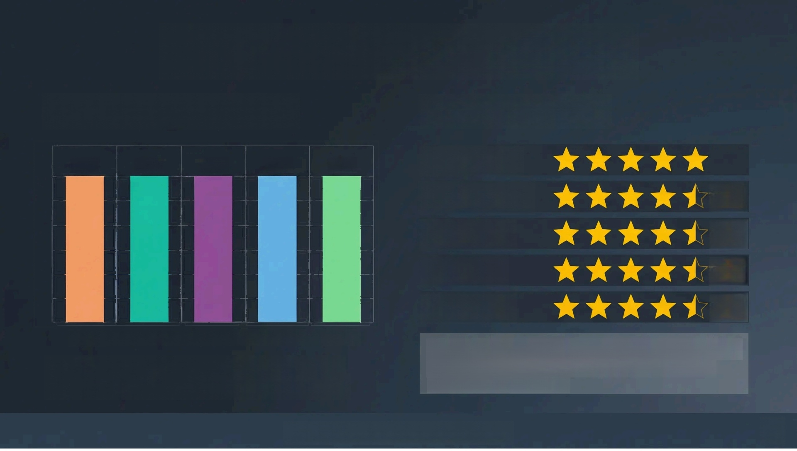

Product Performance Analysis
High Discount Dependency
50% 50% 50% 50% 50%
Hats Sneakers Coats Sweaters Pants
These products show nearly 50%dependency on discounts,indicating customer price conditioning.
Top-Rated Products
Gloves 20pt
Sandals 20pt 4.9
Boots 20pt 4.8
Hats 20pt 4.7
Skirts 20pt 4.6
These highly-rated products are ideal candidates for strategic promotion,homepage placement,and
bundling opportunities
Customer Behavior Analysis Report |2025

Slide 7

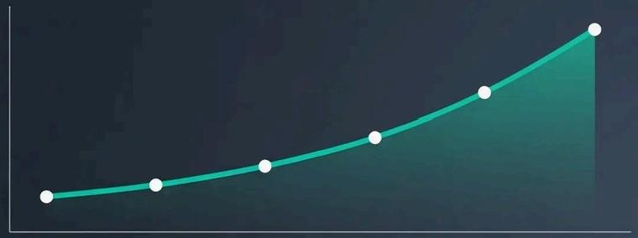
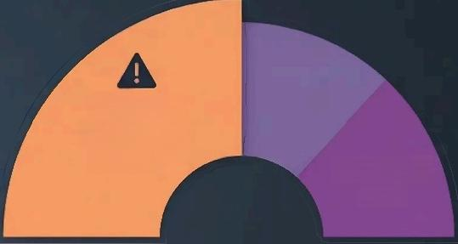
Behavioral Patterns &Churn Risk
Purchase Frequency Insights
Churn Risk Factors
High Risk
Higher churn
probability _{Moderate} Risk
Customer Value(S(
Purchase Frequency(Days Between Orders)
· Customers with purchase intervals <30 days generate significantly higher revenue
·Strong correlation between purchase frequency and total customer value
· Behavioral momentum drives consistent revenue growth
·Highest churn risk: Customers with 5+previous purchases but 45+day purchase gaps
· Discount-dependent customers show reduced long-term consistency
· Heavy discount reliance signals potential value perception issues
Key Finding:While discount-driven customers boost immediate revenue,they present the highest long-term retention risk
Customer Behavior Analysis Report |2025

Slide 8
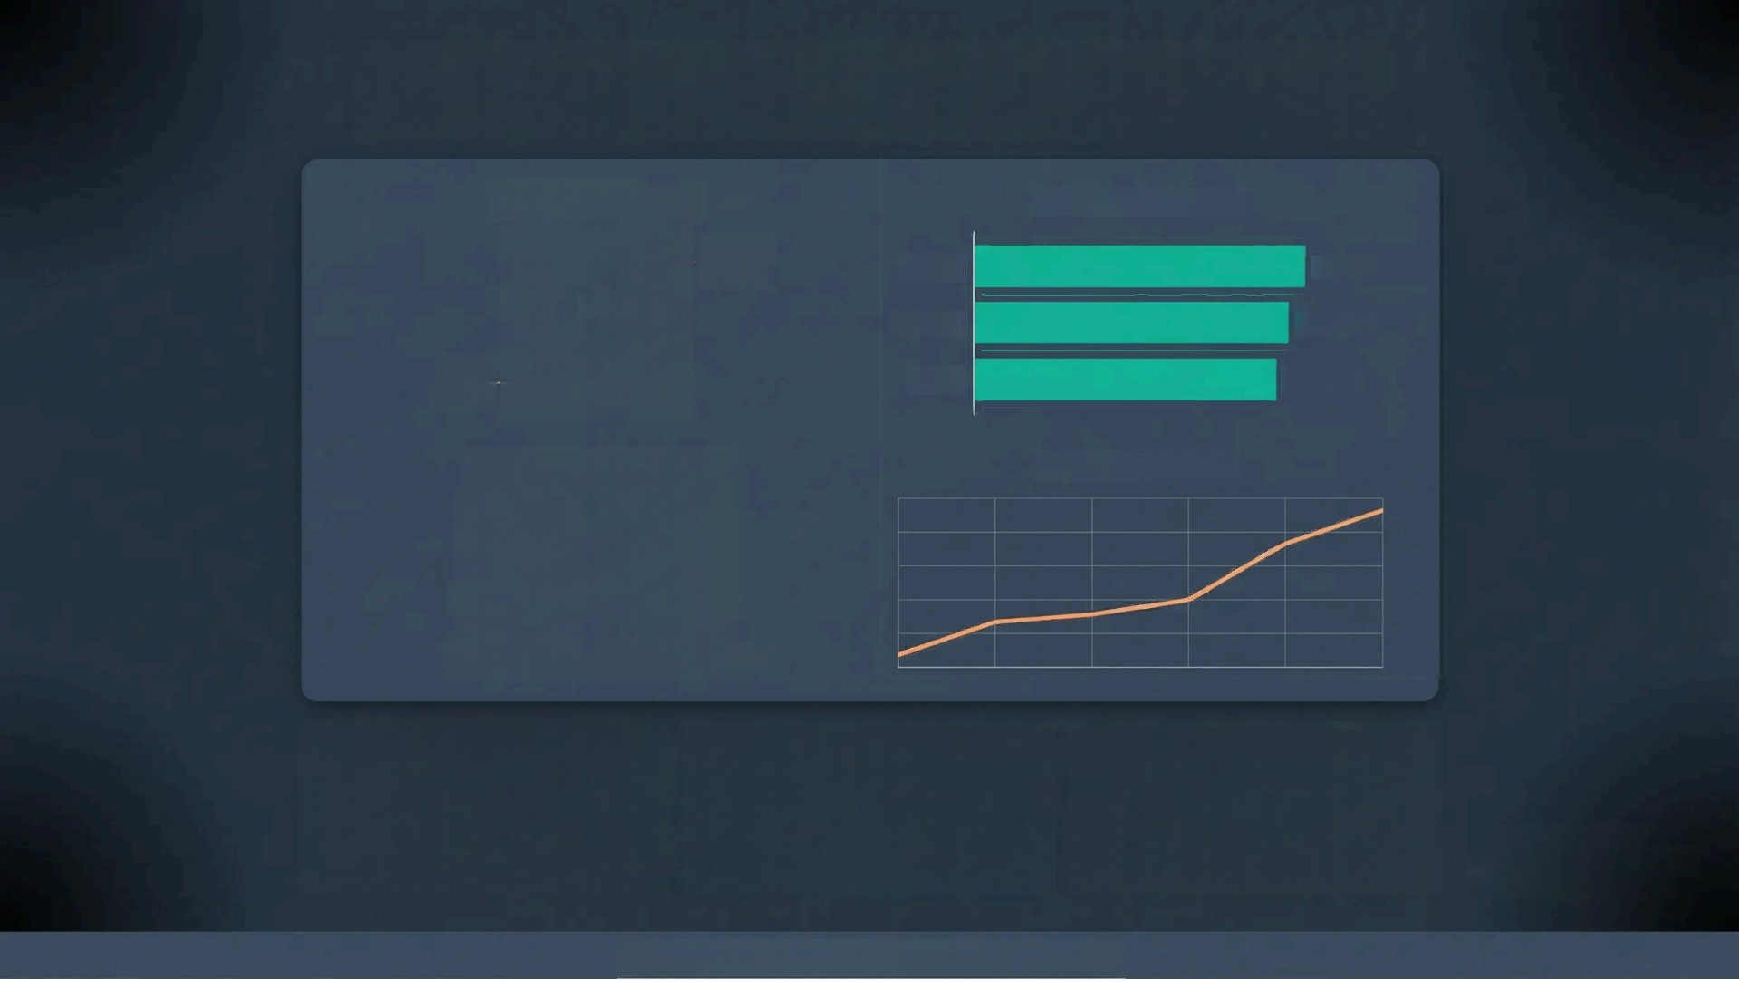
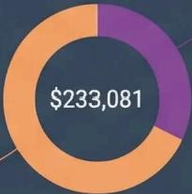
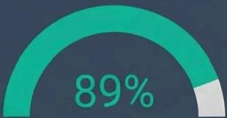


Interactive Dashboard Overview
Revenue by Gender
Top-Rated Products
Gloves
Sandals
Boots
Churn Risk Monitor
Female
32.3%
5 stars
4.8 stars
4.7 stars
Male
67.7%
Loyal Customer Revenue
Revenue from Loyal Customers
Dynamic Filtering
Slice data by age,gender,product category&loyalty status
Real-time KPls
Identifies high churn-risk customers for immediate intervention
Actionable Insights
Translates data patterns into strategic recommendations
Built with
Power BI&DAX, Roboto,16pt
Customer Behavior Analysis Report |2025,Roboto,16pt

Slide 9







Strategic Recommendations
Loyalty Program Enhancement Implement tiered rewards system with personalized offers and early access benefits for loyal customers | Subscription Model Redesign Introduce tangible benefits like shipping privileges,exclusive collections,and priority discounts | Discount Strategy Optimization Reduce deep discounting on high-risk products and transition to bundle-based promotions
Top-Rated Product Promotion Feature high-rated products (Gloves,Sandals,Boots) prominently with Best Seller badges | Targeted Customer Acquisition Increase female customer acquisition and target adult and middle-aged segments | Churn Prevention Campaigns Execute targeted win-back campaigns for high-history inactive customers(45+days gap)
 |  | Based on analysis of 3,900 transactions totaling S233,081 USD
Customer Behavior Analysis Report |2025

Slide 10
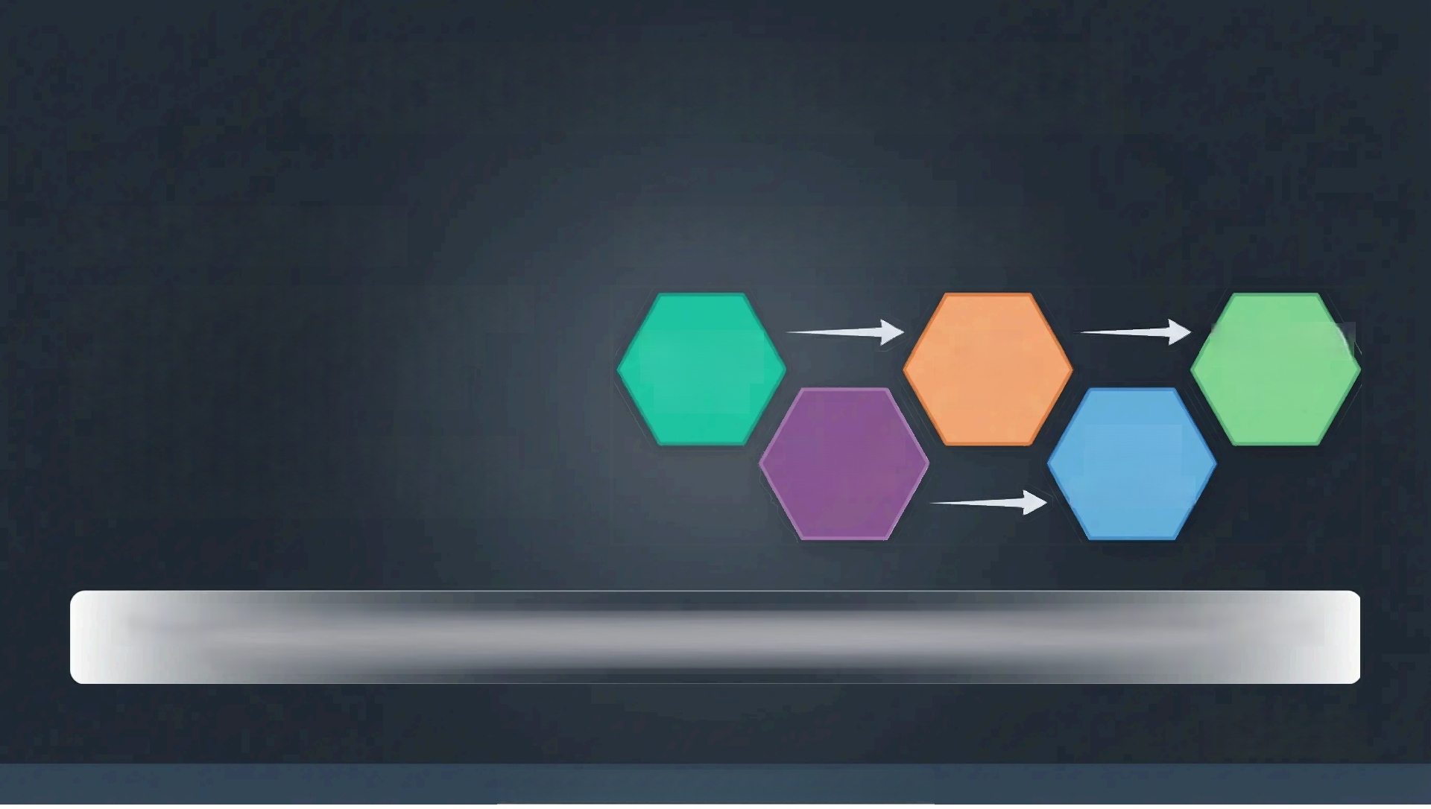
Future Roadmap &Conclusion
Current Limitations
· Absence of transaction timestamps limits trend&seasonal analysis
· No cost or profit data restricts margin optimization
· Customer Lifetime Value modeling
constrained without longitudinal data
Future Analytics Roadmap
Time-Series Transaction Tracking RFM&CLV Modeling | Churn Prediction Models | Subscription Propensity Scoring
 | Discount Elasticity Forecasting
This analysis transformed raw customer data into actionable strategic insights,providing a robust foundation for
improving revenue,strengthening customer loyalty,and enhancing overall customer engagement.
Thank You
Customer Behavior Analysis Report |December 2025

